Slide 1



Unbinding the Cangue: Computational Approaches to Eileen Chang’s Style in French Translation
Kevin Henry & Manon Hayette
University of Mons, Belgium

Slide 2
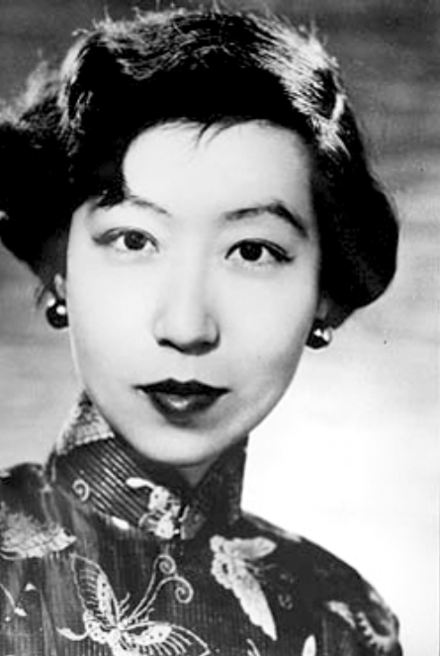
Who was Zhang Ailing?
张爱玲 Zhang Ailing / Eileen Chang (1920–1995)
Renowned and prolific author of contemporary Chinese literature
Gained literary prominence in Japanese-occupied Shanghai and Hong Kong between 1943 and 1945
However, after the Communist takeover of China, she fled the country to live in the United States
Known for her chiselled style full of disillusioned irony, for the strength of her writing and for the depth of her symbolic imagery.
Unique wartime narrative: recount the seemingly irrelevant details and experiences of daily life of ordinary men and women in periods of social change and violence.

Slide 3
Research goals
Unlike English, which has benefited from Chang’s own self-translations, French relies entirely on a single external translator, raising the question of how fully her stylistic complexity has been conveyed to the French-speaking readership.
This paper shows how methodologies from the digital humanities and corpus stylistics can refine literary translation criticism. The study forms part of a broader project aimed at developing a new model for this purpose.

Slide 4
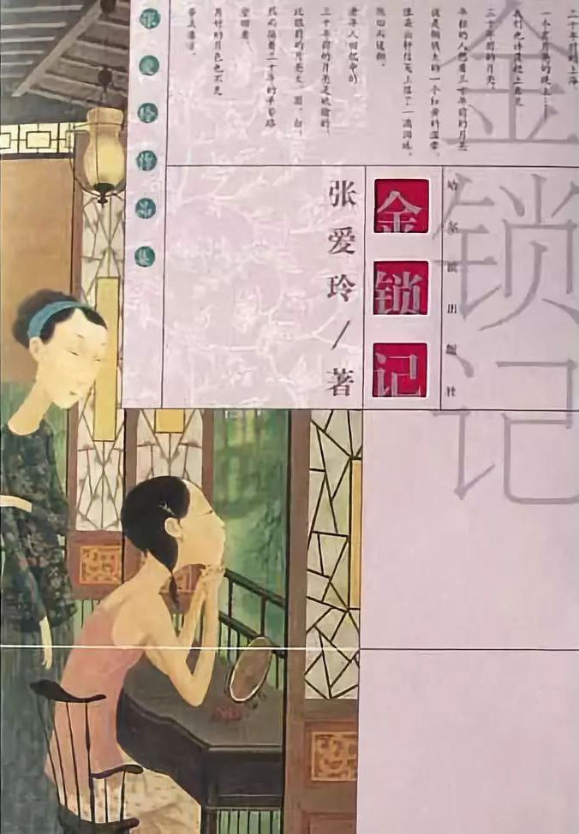
Methodology
Study sample: 金锁记 Jinsuo Ji (Chang 1943/2019)
  La Cangue d’or (1999), transl. Emmanuelle Péchenart.
  Since Lau, Hsiao & Lee (1981) widely viewed as Chang’s masterpiece
Using a corpus of modern Chinese literature processed through the text-analysis platform SketchEngine (Kilgarriff & Rychlý 2003), we extract keywords and frequency lists from the source text to identify the lexical features that characterize Chang’s style.
These results provide criteria for evaluating the French translation and inform the selection of passages for detailed comparative analysis.
The methodology builds on Lance Hewson’s (2011) two-tier model for translation criticism, which we expand by integrating corpus-based lexical extraction into the “critical framework”, following Mastropierro’s (2017) “bag-of-words” approach.

Slide 5

Methodology
Corpus analysis online tool: SketchEngine
Comparison with literary Chinese corpus from the Republican period to extract keywords
Extraction of frequency lists from the original texts
Aim: lexically characterize Zhang Ailing’s style and verify the claims made by literary critics
Selection of excerpts in 金锁记 Jinsuo Ji based on the findings
Critical comparison of Chinese original with the 1999 French translation

Slide 6
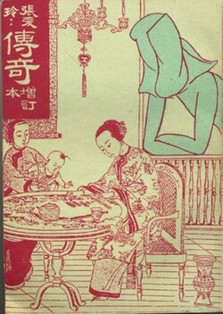
Zhang Ailing corpus
Fifteen major short stories and novellas from the years 1943–1944 contained in the collection 传奇 Chuanqi [Romances], (1944/1946), widely regarded as epitomizing Chang’s oeuvre and having been the subject of several critical analyses (Lin 2007).
留情 Liuqing [Traces of Love] (January 1944) | 沉香屑·第一炉香 Chenxiangxie – Di-yi luxiang [Aloeswood Incense: The First Brazier] (April 1943)
鸿鸾禧 Hongluanxi [Great Felicity] (May 1944) | 沉香屑·第二炉香 Chenxiangxie – Di-er luxiang [Aloeswood Incense: The Second Brazier] (May 1943)
红玫瑰与白玫瑰 Hong meigui yu bai meigui [Red Rose, White Rose] (June 1944) | 琉璃瓦 Liuliwa [The Glazed Tiles] (October 1943)
等 Deng [Waiting] (November 1944) | 心经 Xinjing [The Heart Meridian] (July 1943)
桂花蒸·阿小悲秋 Guihuazheng – A Xiao beiqiu [Shame, Amah! / Steamed Osmanthus Flower – Ah Xiao’s Unhappy Autumn] (September 1944) | 年轻的时候 Nianqing de shihou [In the Years of Youth] (January 1944)
金锁记 Jinsuo ji [The Golden Cangue] (October 1943) | 花凋 Huadiao [A Wilted Flower] (February 1944)
倾城之恋 Qincheng zhi lian [Love in a Fallen City] (September 1943) | 封锁 Fengsuo [Sealed Off / Shutdown] (June 1943).
茉莉香片 Moli xiangpian [Jasmine Tea] (June 1943) | + 色·戒 Se.jie [Lust.Caution] (1979)
Notes:
First corpus = 168,240 words
Lust, Caution => began writing in the 1950s, story set during the war, and made Zhang popular again thanks to Ang Lee’s movie

Slide 7
Republican literature corpus
鲁迅 Lu Xun | 呐喊 Nahan [OutCry] (1923); 彷徨 Panghuang [Wandering] (1925) (collections of novellas and short stories)
老舍 Lao She | 骆驼祥子 Luotuo Xiangzi [Rickshaw Boy] (1936) (novel)
Left-wing prominent writers
茅盾 Mao Dun | 子夜 Ziye [Midnight: A Romance of China] (1933) (novel)
巴金 Ba Jin | 家 Jia [The Family] (1933) (novel)
Jingpai
沈从文 Shen Congwen | 边城 Biancheng [Border Town] (1934) (novella); 长河 Changhe [Long River] (1945) (novel)
Haipai
施蛰存 Shi Zhecun | 将军底头 Jiangjun ditou [The General’s Head] (1932) and 梅雨之夕 Meiyu zhi xi [An Evening of Spring Rain] (1933), two novellas
穆时英 Mu Shiying | 黑牡丹 Hei mudan [Black Peony] (1933); 上海的狐步舞 Shanghai de hubuwu [Shanghai Fox-Trot] (1934); 南北极 Nan-beiji [North Pole, South Pole] (1932); 公墓 Gongmu [Public Cemetery] (1933); 白金的女体塑像 Baijin de nüti suxiang [Statue of a Platinum Woman] (1934); Craven“A” (1932); 夜总会里的五个人 Yezonghui li de wu ge ren [Five in a Nightclub] (1933) (short stories and novellas)
刘呐鸥 Liu Na’ou | 都市风景线 Dushi fengjingxian [Cityscape] (1930) (collection of novellas and short stories)
Female writers
丁玲 Ding Ling | 莎菲女士的日记 Sufei nüshi de riji [Miss Sophia’s Diary/The Diary of Miss Sophie] (1928) (novella)
凌叔华 Ling Shuhua | 绣枕 Xiuzhen [Embroidered Pillows] (1925); 酒后 Jiuhou [Intoxicated] (1925); 中秋晚 Zhongqiuwan [The Night of the Mid-Autumn Festival] (1925); 小哥儿俩 Xiaoger lia [Little Brothers] (1935) (novellas)
Notes:
Second corpus = 666,544 words

Slide 8
SketchEngine: results
Critics of Zhang Ailing (Zhang Yinde, Lee Ou-fan, Kam Louie, etc.) emphasize the importance of physical and psychological descriptions of the characters, namely:
through their (family) status;
through their bodies;
through their garments (including with colours);
through the environment (cities + intimate locales).
Frequency list in Zhang corpus + Keyword list compared to Republican literature corpus

Slide 9
Frequency list: nouns
Item number | Item | Frequency by million | Item number | Item | Frequency by million | Item number | Item | Frequency by million
1 | 个 | 8,187.37 | 18 | 年 | 1,048.92 | 35 | 罗杰 | 670.14
2 | 人 | 5,803.03 | 19 | 点 | 1,044.06 | 36 | 声 | 650.72
3 | 太太 | 3,588.65 | 20 | 流苏 | 1,039.20 | 37 | 今天 | 645.86
4 | 道 | 3,107.90 | 21 | 女人 | 1,029.49 | 38 | 张 | 597.30
5 | 先生 | 1,680.21 | 22 | 振保 | 946.94 | 39 | 小寒 | 558.45
6 | 手 | 1,558.80 | 23 | 孩子 | 898.38 | 40 | 嘴 | 548.74
7 | 时候 | 1,519.96 | 24 | 来 | 888.66 | 41 | 头发 | 548.74
8 | 天 | 1,383.99 | 26 | 句 | 825.54 | 42 | 香港 | 543.88
9 | 事 | 1,330.57 | 27 | 次 | 806.11 | 43 | 心 | 529.31
10 | 话 | 1,311.14 | 28 | 母亲 | 786.69 | 44 | 家里 | 519.60
11 | 脸 | 1,301.43 | 29 | 种 | 772.12 | 45 | 小姐 | 514.75
12 | —— | 1,209.17 | 30 | 梁 | 757.55 | 46 | 人家 | 509.89
13 | 只 | 1,204.31 | 31 | 件 | 742.98 | 47 | 柳原 | 505.03
14 | 家 | 1,146.04 | 32 | 身 | 713.85 | 48 | 电话 | 505.03
15 | 薇龙 | 1,136.33 | 33 | 眼睛 | 699.28 | 49 | 眼 | 495.32
16 | 现在 | 1,131.47 | 34 | 老太太 | 684.71 | 50 | 传庆 | 480.75
17 | 头 | 1,092.62 | 26 | 句 | 825.54

Slide 10
Keyword list
Item number | Item | Relative frequency (focus) | Relative frequency (reference) | Item number | Item | Relative frequency (focus) | Relative frequency (reference) | Item number | Item | Relative frequency (focus) | Relative frequency (reference)
1 | 她 | 16,335.89 | 7,260.67 | 18 | 巧 | 1,000.35 | 17.36 | 35 | 喜欢 | 679.85 | 200.93
2 | 道 | 6,968.49 | 560.61 | 19 | 得 | 4,448.18 | 3,620.41 | 36 | 敦凤 | 466.18 | 0.00
3 | 太太 | 3,588.65 | 524.64 | 20 | 七 | 1,116.90 | 297.67 | 37 | 仿佛 | 820.68 | 355.96
4 | 一 | 18,982.46 | 16,129.99 | 21 | 没 | 1,957.00 | 1,147.27 | 38 | 长安 | 461.33 | 1.24
5 | 你 | 10,192.93 | 7528,57 | 22 | 只 | 3,297.28 | 2,511.59 | 39 | 米 | 480.75 | 35.97
6 | 了 | 29,923.22 | 27,234.32 | 23 | 梁 | 757.55 | 3.72 | 40 | 身 | 713.85 | 275.34
7 | 着 | 11,033.04 | 9,329.47 | 24 | 老太太 | 684.71 | 12.40 | 41 | 声道 | 441.90 | 3.72
8 | 笑 | 3,049.62 | 1,467.27 | 25 | 罗杰 | 670.14 | 0.00 | 42 | 别 | 655.57 | 218.29
9 | 上 | 6,108.96 | 4,884.27 | 26 | 女人 | 1,029.49 | 370.85 | 43 | 爱 | 980.93 | 548.21
10 | 薇龙 | 1,165.46 | 0.00 | 27 | 手 | 1,558.80 | 942.62 | 44 | 白 | 796.40 | 367.13
11 | 是 | 15,131.58 | 13,952.04 | 28 | 与 | 1150.89 | 548.21 | 45 | 双 | 592.44 | 167.44
12 | 振保 | 1,160.61 | 0.00 | 29 | 孩子 | 898.38 | 351.00 | 46 | 向 | 1,277.15 | 852.08
13 | 小寒 | 1,141.18 | 0.00 | 30 | 传庆 | 529.31 | 0.00 | 47 | 娇蕊 | 422.48 | 0.00
14 | 里 | 5,676.77 | 4,579.16 | 31 | 香港 | 543.88 | 26.05 | 48 | 太 | 1,087.76 | 668.52
15 | 像 | 1,991.00 | 902.93 | 32 | 柳原 | 514.75 | 0.00 | 49 | 替 | 626.44 | 213.33
16 | 流苏 | 1,053.77 | 1.24 | 33 | 人 | 5,803.03 | 5,303.49 | 50 | 母亲 | 786.69 | 385.73
17 | 先生 | 1,680.21 | 694.56 | 34 | 愫细 | 495.32 | 0.00

Slide 11
SketchEngine: results
The results of our statistical analysis only partially align with the conclusions drawn by literary critics.
Undeniably, women play a dominant role in Chang’s narratives, even if their attires do not stand out, notwithstanding their assumed metaphorical and narratological primacy.
Descriptions appear to be more significant in Chang’s fiction than in the prose of other modern Chinese writers, despite the use of a relatively limited number of adjectives (especially colours).
Furthermore, the focus on the intimacy of the characters is supported by the prevalence of affection verbs, family nouns, and terms referring to body parts.
However, there is a notable dearth of allusions to dwellings in the most common words.
Throughout Chang’s novels, the characters’ socio-psychological calculations are both “masked” and “emphasised” by the repetitive use of “笑道 xiao dao”, a phrase inherited from classical Chinese novels which illustrates the tone of the characters when they speak.

Slide 12
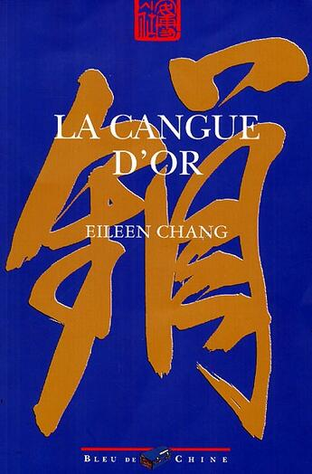
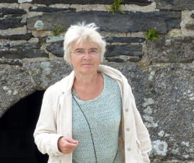
Analysis of excerpts

Slide 13
Analysis of one excerpt in The Golden Cangue
Excerpt picked due to their featuring of salient themes identified as characteristic of Chang’s style both by scholarly analysis and lexical statistics: woman’s body, family status, descriptive verbs, and “笑 xiao” “laugh/smile”.
Example (1) was taken towards the conclusion and illustrates the supposed importance of attire and character description in Chang’s work as a means of revealing the condition of women, “mentally imprisoned by traditional values” (Zhang 2003:349). In this excerpt, Cao Qiqiao’s daughter, Chang’an, is preparing for her inaugural date with her future husband.

Slide 14
赴宴的那天晚上，长馨先陪她到理发店去用钳子烫了头发，从天庭到鬓角一路密密的贴着细小的发圈，耳朵上戴了二寸来长的玻璃翡翠宝塔坠子，又换上了苹果绿乔琪纱旗袍，高领圈，荷叶边袖子，腰以下是半西式的百褶裙。一个小大姐蹲在地上为她扣揿钮，长安在穿衣镜里端详着自己，忍不住将两臂虚虚的一伸，裙子一踢，摆了个葡萄仙子的姿势，一扭头笑了起来道："把我打扮得天女散花似的！(Chang 1943/2019: 251)
Le soir prévu pour la réception, Alise l’accompagna chez le coiffeur, où on la frisa au fer ; une rangée d’accroche-cœur lui enserrait la tête depuis le haut du front jusqu’au cou ; parée de pendants d’oreilles ornés de gouttes d’une précieuse jadéite translucide, longs de plus de deux pouces, elle revêtit une robe à haut col de crêpe Georgette vert pomme, garnie de volants aux manches, dont la jupe plissée s’évasait à la mode occidentale. Une dame de compagnie agenouillée à ses pieds pour lui ajuster ses boutons, Alme, qui se contemplait dans la psyché, ne put s’empêcher d’ouvrir les bras dans le vide et de faire bouffer sa jupe du pied, pour prendre une pose de la Fée des vignes : « Me voici comme la Déesse aux fleurs ! » dit-elle en tournant la tête avec un grand sourire. (Chang/Péchenart 1999 : 87)

Slide 15
Conclusions
Taking Eileen Chang’s as a starting point and her piece of work The Golden Cangue as an illustration, this pilot study on the use of corpus-based analysis tools to objectify translation criticism suggests the potential for developing a model for this endeavour by incorporating a second step prior to Hewson’s “critical framework”.
Verification through corpora and computational stylistics focusing on frequency and keyword lists could prove instrumental in quantitatively corroborating and validly complementing claims regarding an author’s style that commentators made based on their knowledge and interpretation of the text. Therefore, corpus stylistics should be an integral part in translation criticism as it could help building a “critical framework” and selecting excerpts for further qualitative analyses.
This study forms part of a broader research project currently being conducted in our laboratory, with the aim of developing a more objective and efficient model for translation criticism combining quantitative and qualitative analyses. The next stage of this process would be to apply the same approach to not only the critical framework and the selection of excerpts and passages to consider, but also the criteria used to evaluate each extract. In that matter, the succinct and preliminary analyses that we conducted on two excerpts from The Golden Cangue will definitely need elaboration.

Slide 16
References
Chang, Eileen. 1999. La Cangue d’or, trans. Emmanuelle Péchenart. Paris: Bleu de Chine.
张爱玲 Chang, Eileen. 2019. 《张爱玲全集》 Zhang Ailing quanji [Zhang Ailing’s Complete Works], 5 volumes. Beijing: Beijing Publishing Group.
Chou, Tan-Ying. 2013. “The Golden Cangue : auto-traduction d’Eileen Chang”. Impressions d’Extrême-Orient 3, consulted on September 28, 2024. https://journals.openedition.org/ideo/286?lang=en
Hewson, Lance. 2011. An Approach to Translation Criticism – Emma and Madame Bovary in Translation. Amsterdam & Philadelphia: John Benjamins.
Huang, Libo. 2015. Style in Translation: A Corpus-Based Perspective. Shanghai: Shanghai Jiao Tong University Press.
Kam, Louie (ed.). 2012. Eileen Chang: Romancing Languages, Cultures and Genres. Hong Kong: Hong Kong University Press.
Kilgarriff, Adam & Rychlý, Pavel. 2003. SketchEngine. Lexical Computing Ltd. https://www.sketchengine.eu/.
Lau, Joseph S. M., Hsia, C. T. & Lee, Leo Ou-fan (eds.). 1981. Modern Chinese stories and novellas: 1919–1949. New York: Columbia University Press.

Slide 17
References
Lee, Leo Ou-fan. 1999. Shanghai Modern: The Flowering of a New Urban Culture in China, 1930–1945. Cambridge: Harvard University Press.
Lin, Wei-Hsin. 2007. A Theoretical Study of Zhang Ailing’s Short Story Collection Chuanqi. PhD thesis. London: School of Orienal and African Studies.
Mastropierro, Lorenzo. 2017. Corpus Stylistics in Heart of Darkness and Its Italian Translations. London: Bloomsbury.
Péchenart, Emmanuelle. 2002. Le discours narratif dans Jinsuo Ji (La Cangue d’or) de Zhang Ailing (Eileen Chang) : les procédés de l’auteur, les choix du traducteur. PhD thesis. Paris: École des hautes études en sciences sociales.
Péchenart, Emmanuelle. 2010. “Eileen Chang – Shanghaïenne, décidément.” In Shanghai : Histoire, promenades, anthologie et dictionnaire, ed. by Nicolas Idier, 566–582. Paris: Robert Laffont.
Xiao, Richard (ed). 2010. Using Corpora in Contrastive and Translation Studies. Newcastle: Cambridge Scholars Publishing.
Zanettin, Federico. 2013. “Corpus methods for descriptive translation studies.” Procedia – Social and Behavioral Sciences 95: 20–32.
Zhang, Yinde. 2003. Le Monde romanesque chinois au XXe siècle. Paris: Honoré Champion.

Slide 18

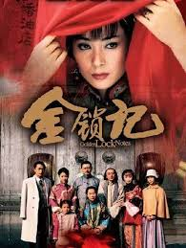
Thank you for your attention!

